Slide 1

Group 11
Submission Form App: A Deep Dive into Form Submission Systems
Explore the architecture and functionality of the Submission Form App, a robust solution for managing form submissions.

Slide 2

Key Tools in Our Workflow
1
Postman API
2
Visual Studio & .NET Framework
Testing and interacting with our backend APIs.
Developing the VB.NET Windows Forms application.
3
XAMPP
4
Getform (for comparison)
Local server environment for PHP backend and data storage.
Understanding third-party service alternatives.

Slide 3
Project Aim: Building a Full-Featured Submission System
Core Technologies
Overall Objective
To enable comprehensive CUVD/CRUD operations (Create, View, Update, Delete) for form submissions without reliance on external services like Getform, showcasing a professional, interactive application.
VB.NET Windows Forms: User Interface
XAMPP (PHP + Apache): Backend Server
JSON File Storage: Data Management

Slide 4
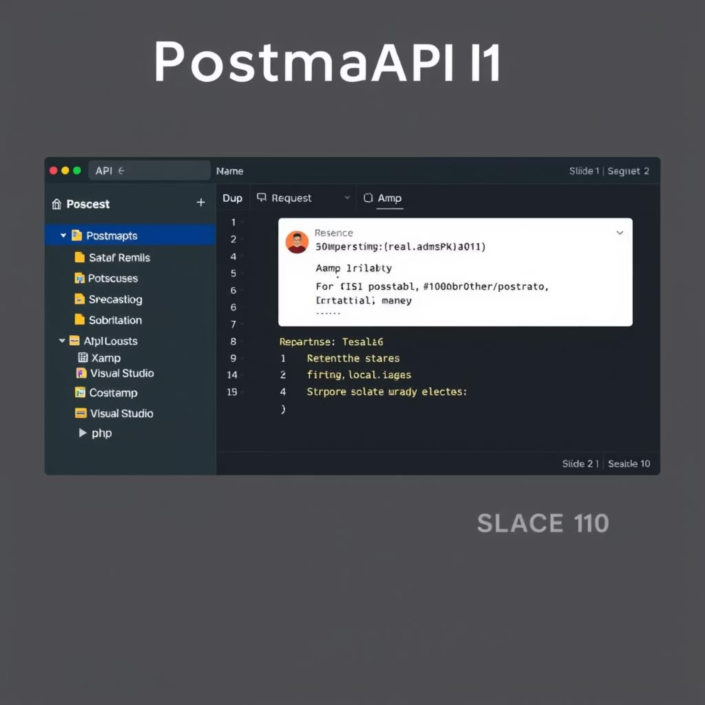
Leveraging Postman for API Testing
Postman is an essential client app for interacting with APIs that support readable methods like GET, PUT, or DELETE. It allows developers to:
Send various API requests
(GET, POST, PUT, DELETE)
View and analyze API responses
Simulate client applications,
such as our VB.NET app
It's primarily used for testing the APIs hosted in XAMPP, ensuring reliable communication between frontend and backend.

Slide 5




Understanding XAMPP: Your Local Server Stack
Apache
MySQL
Handles HTTP requests and
serves web pages.
Manages databases, though we're using JSON files here.
PHP (or Perl)
Executes server-side scripts for API logic.
XAMPP provides a complete environment for local development,
ideal for hosting PHP-based APIs.

Slide 6
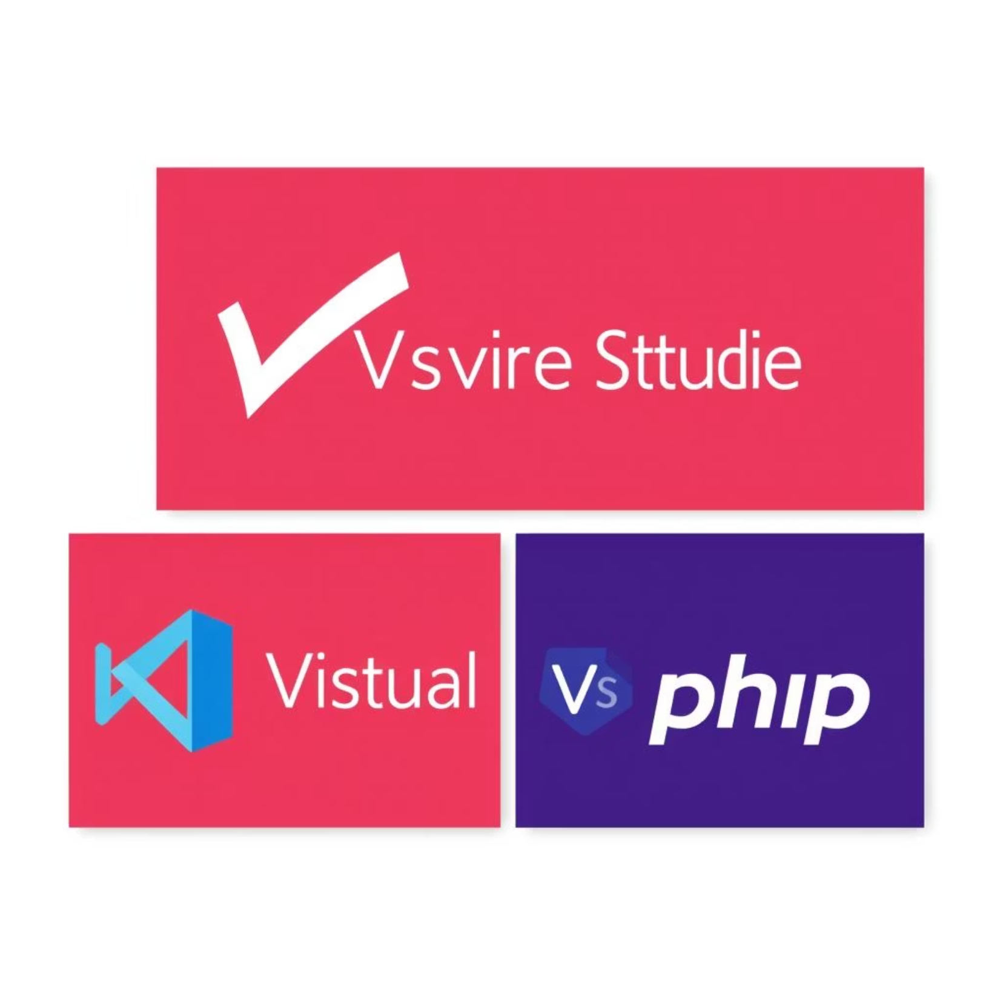
Visual Studio: The .NET IDE
Visual Studio serves as the Integrated Development Environment (IDE) where the VB.NET Windows Forms application was crafted using the .NET framework.
Comprehensive code editor
Debugging tools
UI design capabilities for Windows Forms
Seamless integration with .NET libraries

Slide 7





Group 11 App Scope: Data Management and API Interaction
Record Data
Capturing new form submissions.
Update Data
Modifying existing submission records.
Delete Data
Removing old or unwanted submissions.
Postman API
Facilitating all API requests (GET, POST, PUT, DELETE).
The Submission app aims to provide a complete data lifecycle management system, with potential for integration with services like Getform.

Slide 8
Implementation Steps
XAMPP Setup
Installation and configuration of the local server environment.
PHP API Files (CRUD & JSON)
Developing the backend API for Create, Read, Update, Delete, and JSON handling.
Running API Locally
Ensuring the PHP API is accessible via XAMPP.
Postman API Testing
Validating API endpoints and responses.
Connect VB.NET App
Integrating the frontend application with the local API.

Slide 9
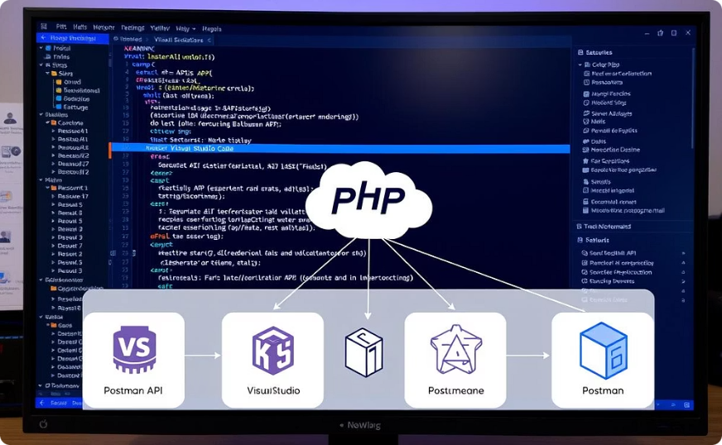
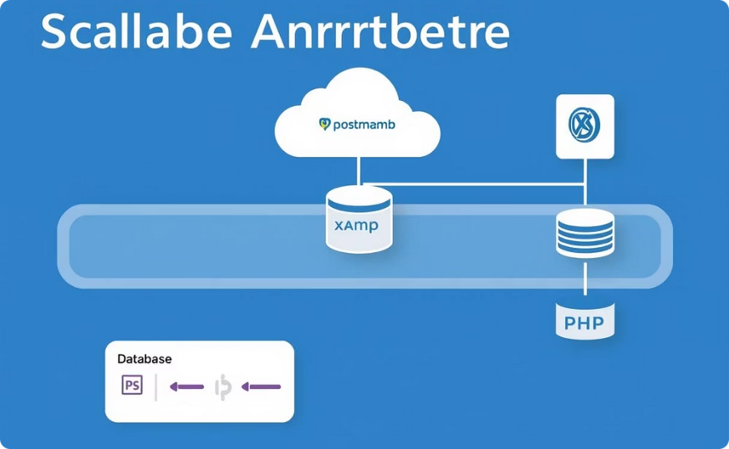
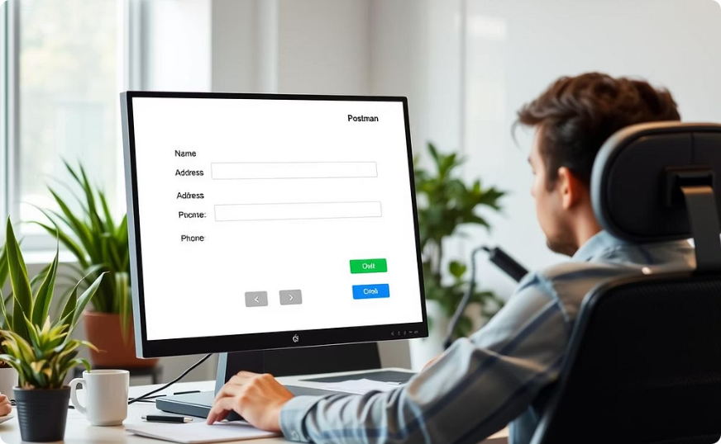
Why This Project is Meaningful
Full Stack Skill Integration
Blends frontend (UI controls, regex validation) and
backend (API calls, HTTP methods) development.
Foundation for Scalable Apps
Prepares for future expansion:
MySQL integration, cloud sync, real web servers.
Real-World Use Case Simulation
Simulates data entry, time
tracking, secure input
validation, and robust form storage.

Slide 10
Questions & Contact
Any questions?
We are Group 11, and Submission App is our project.
Apea Aninakwa Dankwa - 4121230012
Kwarteng Rexford Kweku George - 4121230026
Gideon Appiah Acheampong - 4121231020

